Slide 1
Functions and Serial Communication in Arduino
CSE 315
Peripherals & Interfacing

Slide 2
Function

Slide 3
What is Function?
Functions are the block of code which allows a programmer to create modular pieces of code that perform a defined task and then return to the area of code from which the function was "called".
The typical case for creating a function is when one needs to perform the same action multiple times in a program

Slide 4

Advantages of Function:
Functions help the programmer stay organized. Often this helps to conceptualize the program.

Slide 5

Advantages of Function: (contd.)
Functions codify one action in one place so that the function only has to be thought out and debugged once.

Slide 6

Advantages of Function: (contd.)
This also reduces chances for errors in modification, if the code needs to be changed.

Slide 7

Advantages of Function: (contd.)
Functions make the whole sketch smaller and more compact because sections of code are reused many times.
Reduce
Reuse

Slide 8

Advantages of Function: (contd.)
They make it easier to reuse code in other programs by making it more modular, and as a nice side effect, using functions also often makes the code more readable.

Slide 9
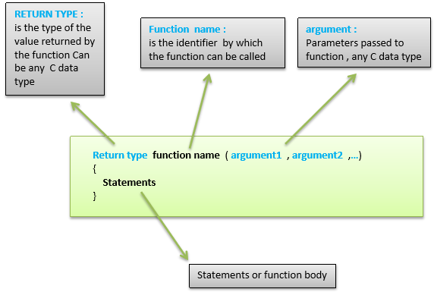
How Function looks like?

Slide 10
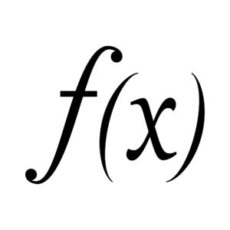
Function declaration in Arduino:
A function is declared outside any other functions, above or below the loop function.

Slide 11
Function declaration in Arduino: (contd.)
We can declare the function in two different ways –
Function Prototyping
Function Definition

Slide 12
Function Prototyping:
The first way is just writing the part of the function called a function prototype above the loop function, which consists of −
Function return type
Function name
Function argument type, no need to write the argument name
Function prototype must be followed by a semicolon ( ; ).

Slide 13
Function Prototyping: (contd.)
int sum_func (int x, int y) // function declaration
{
int z = 0;
z = x+y ;
return z; // return the value
}
void setup () {
Statements // group of statements…..
}
Void loop () {
int result = 0 ;
result = Sum_func (5,6) ; // function call
}

Slide 14
Function Definition:
The second part, which is called the function definition or declaration, must be declared below the loop function, which consists of −
Function return type
Function name
Function argument type, here you must add the argument name
The function body (statements inside the function executing when the function is called)

Slide 15
Function Definition: (contd.)
int sum_func (int , int ) ; // function prototype
void setup () {
Statements // group of statements
}
Void loop () {
int result = 0 ;
result = Sum_func (5,6) ; // function call
}
int sum_func (int x, int y) // function declaration {
int z = 0;
z = x+y ;
return z; // return the value
}

Slide 16
Class work:
Write a sketch with function to find the average of two numbers:

Slide 17
Serial Communication

Slide 18
Use of Serial:
Used for communication between the Arduino board and a computer or other devices. All Arduino boards have at least one serial port (also known as a UART or USART), and some have several.

Slide 19
Serial.begin():
Sets the data rate in bits per second (baud) for serial data transmission. For communicating with Serial Monitor, make sure to use one of the baud rates listed in the menu of Arduino. You can, however, specify other rates - for example,
to communicate over pins 0 and 1 with a component that requires a particular baud rate.

Slide 20
Serial.begin(): (contd.)
void setup() {
Serial.begin(9600); // opens serial port, sets data rate to 9600 bps
}
void loop() {}

Slide 21
Serial.print():
Prints data to the serial port as human-readable ASCII text. This command can take many forms. Numbers are printed using an ASCII character for each digit. Floats are similarly printed as ASCII digits, defaulting to two decimal places. Bytes are sent as a single character. Characters and strings are sent as is. For example:
Serial.print(78) gives "78"
Serial.print(1.23456) gives "1.23"
Serial.print('N') gives "N"
Serial.print("Hello world.") gives "Hello world."

Slide 22
Serial.print(): [second parameter]
An optional second parameter specifies the base (format) to use; permitted values are BIN(binary, or base 2), OCT(octal, or base 8), DEC(decimal, or base 10), HEX(hexadecimal, or base 16). For floating point numbers, this parameter specifies the number of decimal places to use. For example-
Serial.print(78, BIN) gives "1001110"
Serial.print(78, OCT) gives "116"
Serial.print(78, DEC) gives "78"
Serial.print(78, HEX) gives "4E"
Serial.print(1.23456, 0) gives "1"
Serial.print(1.23456, 2) gives "1.23"
Serial.print(1.23456, 4) gives "1.2346"

Slide 23
Printing Decimal and Binary of a number:
void setup() {
Serial.begin(9600); // open the serial port at 9600 bps:
}
void loop() {
// print labels
Serial.print("DEC");
Serial.print("\t");
Serial.print("BIN");
Serial.println(); // carriage return after the last label
for (int x = 0; x < 10; x++) { // only part of the ASCII chart, change to suit
// print it out in two formats:
Serial.print(x, DEC); // print as an ASCII-encoded decimal
Serial.print("\t"); // prints a tab
Serial.print(x, BIN); // print as an ASCII-encoded binary
Serial.println();
delay(200); // delay 200 milliseconds
}
Serial.println(); // prints another carriage return
}

Slide 24
Printing Decimal and Binary of a number: (Output)
Dec Bin
0 0000
1 0001
2 0010
3 0011
4 0100
5 0101
. . . . .
. . . . .
9 1001

Slide 25
Serial.end()
Disables serial communication, allowing the RX and TX pins to be used for general input and output. To re-enable serial communication, call Serial.begin().

Slide 26
Incorporating Function and Serial:
int myMultiplyFunction(int x, int y){ int result; result = x * y; return result; }
void setup(){ Serial.begin(9600); } void loop() { int i = 2; int j = 3; int k; k = myMultiplyFunction(i, j);
Serial.println(k); // k now contains 6 }

Slide 27
Write a sketch with function to find the average of three numbers with serial output (after decimal- “.” it will print 4 numbers):

Slide 28
Reading Assignments:
Serial.write()
Serial.println()
Serial.available()
Serial.read()

Slide 29
Thank you

